Slide 1
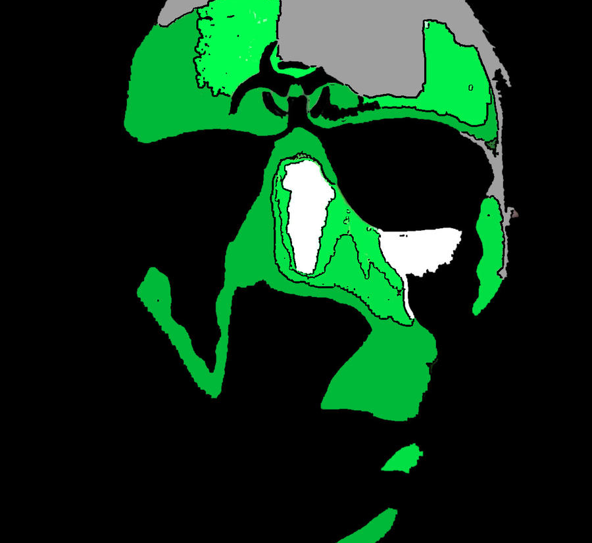
Toxic Comments Classification using Knowledge Distillation
RA - SANIA AZHMEE BHUIYAN
ST - FARAH BINTA HAQUE
Presented by :
Shadman Ahmad Nafee
20341033
Jannatus Sakira Khondaker
20301468

Slide 2
Introduction
Online platforms often harbor toxic comments, harmful expressions targeting individuals or groups based on attributes like skin color, sexuality, religion, etc
This project aims to classify such comments using knowledge distillation, a technique transferring knowledge from a large model to a smaller one
This approach overcomes the limitations of existing models that require extensive resources, making the classification process more efficient and scalable

Slide 3
Literature Review
Various machine learning and deep learning methods, including SVM, Naive Bayes, Logistic Regression, CNN, RNN, and BERT, have been used to detect toxic comments
Transfer learning techniques like BERT and knowledge distillation have been employed to address these issues
Notably, this is the first study to use knowledge distillation to transfer learning from DistilBERT to a custom BERT-like model for low-resource toxic comment classification

Slide 4
Plan
We propose to use DistilBERT , a thinned version of BERT, as the teacher model, and a smaller custom specially designed BERT-type model , as the student model
Our aim is to show that this custom model can achieve comparable performance to DistilBERT, while being 65% faster and significantly smaller in size
We also compare custom BERT with other basic machine learning algorithms such as Logistic Regression, Decision Tree, Random Forest, and XG-Boost Data Collection: Data collection: We use a dataset provided by Google Jigsaw in December 2017 as part of the Kaggle 'Toxic Comment Classification Challenge’

Slide 5
Methodology
We employ the SimpleTransformers library and basic machine learning techniques to construct our solution
Knowledge distillation is used to transfer information from the teacher model to the student model, with a combined language modeling and distillation loss function
The performance of pre-trained models is compared using algorithms like Logistic Regression, Decision Tree, Random Forest, and XG-Boost

Slide 6
Challenges
The comments contained various types of noise, including spelling errors, slang, abbreviations, emoticons, and sarcasm
Toxic comment classification is a sensitive task that can have ethical and social implications
This way, we aimed to create a solution that is not only effective but also respectful of diverse perspectives and experiences

Slide 7
Conclusion
In this project, we will use knowledge distillation to classify toxic comments, with DistilBERT as the teacher model and custom BERT model as the student model
It will outperform basic machine learning algorithms in precision, recall, accuracy, and F1-score
Our approach will prove effective for toxic comment classification and other natural language processing tasks, despite some challenges and limitations

Slide 8

Reference
https://ieeexplore.ieee.org/stamp/stamp.jsp?tp=&arnumber=9785067
https://ieeexplore.ieee.org/stamp/stamp.jsp?tp=&arnumber=9120939
https://norma.ncirl.ie/6132/1/bijendergupta.pdf

